Slide 1
3D Image Segmentation and Quantification of Lysosomes
18/1/2025

Slide 2
GUI

Slide 3
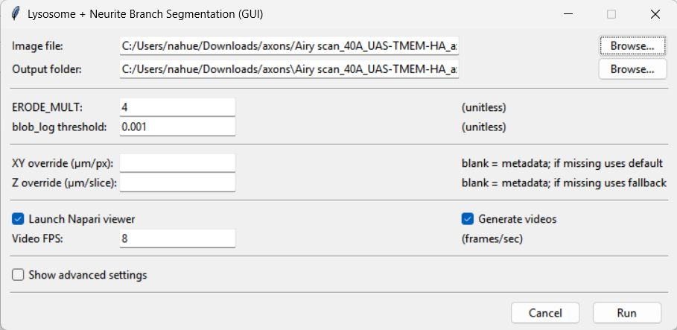
GUI WITHOUT ADVANCED SETTINGS
1
2
3
4
5
6
7
8
7
9
10
11

Slide 4
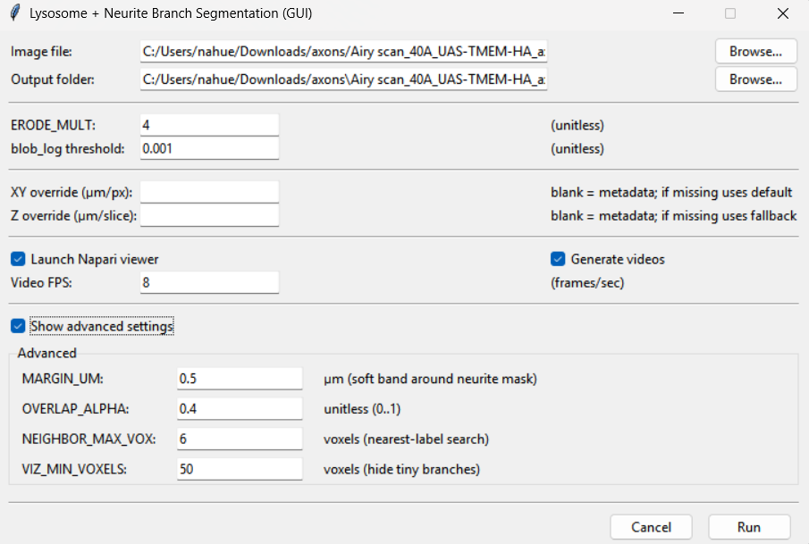
GUI WITH ADVANCED SETTINGS
12
13
14
15

Slide 5
Inputs and buttons
1) Image file
Text box
Shows the full path of the file you selected (.czi, .tif, .tiff).
Browse… (button)
Opens a file picker. When you choose a file, the GUI also auto-suggests an output folder (same directory as the image + timestamp) if the output field is empty.
2) Output folder
Text box
Where all outputs are written:datasets, videos and pictures
Browse… (button)
Lets you choose a parent folder.
The script then makes a new timestamped folder inside it (based on the image name).
3) ERODE_MULT
ERODE_MULT (input): A multiplier / additive factor used in your auto morphology stage.
Units: unitless (it becomes a voxel radius for erosion).
Effect: higher values generally shrink the mask more (more erosion).
For neurites: too high will break thin branches.
Typical:
Image with little noise: 0-2
Image with a lot of noise: 3-6
Neurites-only: often 0–1 (or even force erosion off)

Slide 6
Inputs and buttons
4) Blob_log threshold
Input:
Controls how strict the lysosome detection is using the function blog_log.It’s basically the minimum “blob response” required to call something a blob.
Units: unitless.
Effect:
Lower threshold → more detections (including noise)
Higher threshold → fewer detections (may miss lysosomes)
Typical: 0.001–0.05, depends on intensity / noise.
5) XY override (µm/px)
Input
If you leave it blank: the script tries metadata (vx_um, vy_um)
if missing → uses the default you set (e.g. 0.04 µm/px)
If you fill it: it forces vx_um = vy_um = your_value
Units: micrometers per pixel (µm/px)
Affects: any calculation converting pixels → µm, including: lysosome size in µm, distance maps in µm, MARGIN_UM behavior (because it’s in µm) and voxel volume in µm³.

Slide 7
Inputs and buttons

Slide 8
AXONS

Slide 9


